Slide 1

Sales Analysis
Project Type: EDA & Dashboard
Submitted by: Dipangi Jadav

Slide 2
Problem Statement
For this project we will be analysing sales target data. This data set contains 3 years of sales.
This main objective behind this project to explore and analyze following insights:
Sales over Time
Sales for various Products
Manager wise analysis
Customer coverage across various Locations
Target Analysis

Slide 3
Data Overview
Dimension tables and columns are as below:
Customer : Customer ID, Company Name, Status, Line of Business, City, State
Product: Product ID, Product, Group ID
ProductGroup : Group ID, Group, Category
SalesPerson : SalesPerson ID, SalesPerson, Supervisor ID, Supervisor, Manager ID, Manager, Team
Dates: Dates, Year, Month Name, Month, Day

Slide 4
Data Overview
3 years of sales data, which contains name and column as below:
Sales 2017 : Issue Date, Due Date, Invoice Number, Customer ID, SalesPerson ID, Product ID, Qty Items, Unit Price, Net Weight
Sales 2018 : Issue Date, Due Date, Invoice Number, Customer ID, SalesPerson ID, Product ID, Qty Items, Unit Price, Net Weight
Sales 2019 : Issue Date, Due Date, Invoice Number, Customer ID, SalesPerson ID, Product ID, Qty Items, Unit Price, Net Weight
Target Data which has columns like SalesPerson ID, Month name and year, Total sales month wise.

Slide 5
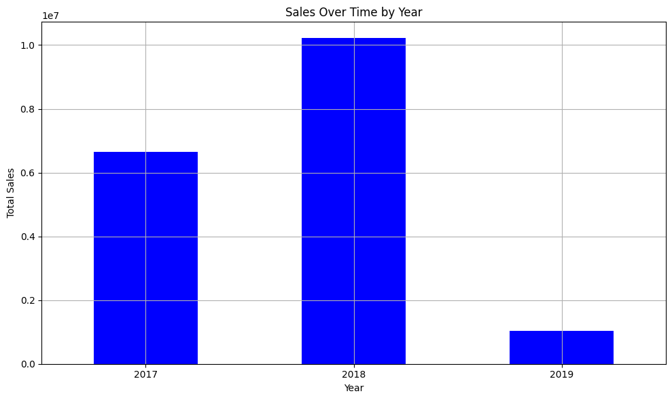
Sales over Time
As we can see here, year 2018 has the more sales compare to other years.

Slide 6
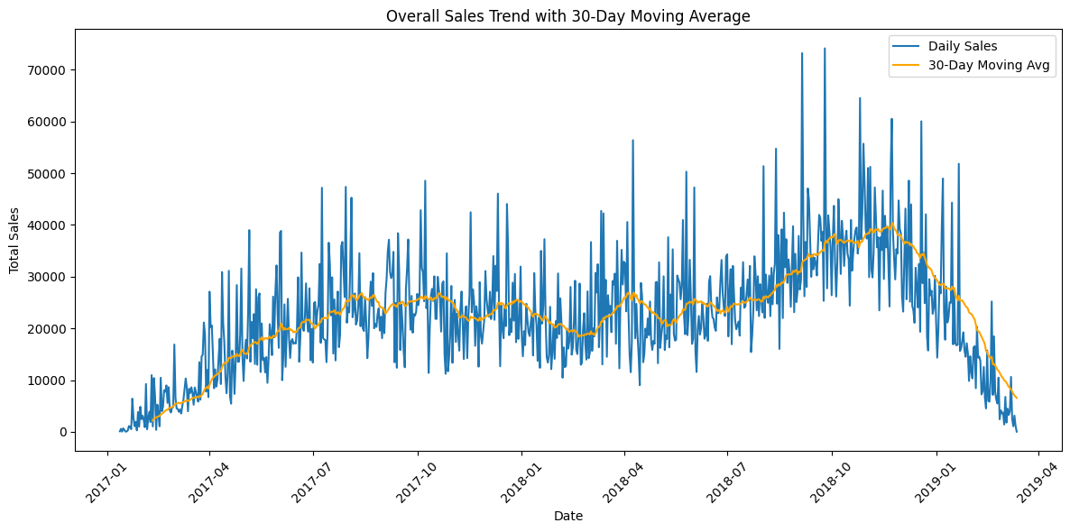
Sales by seasonal pattern
Here, we can see the pattern like sales is increasing in the months of July to December and the from January it is decreasing for each years.

Slide 7
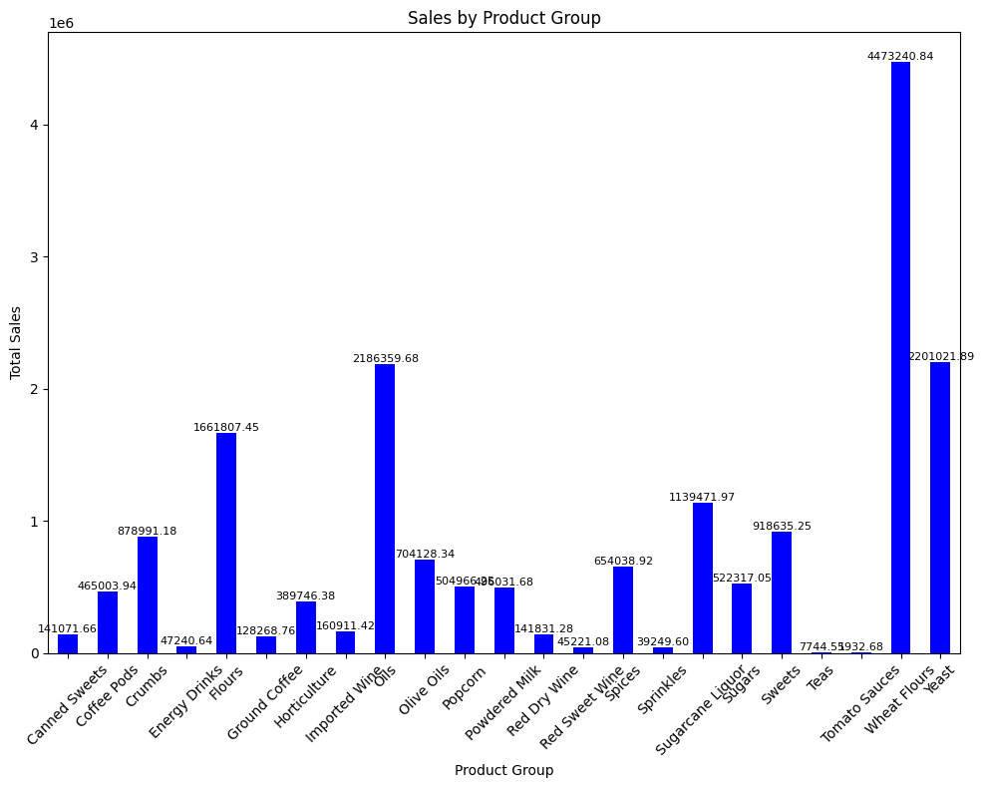
Sales by Product Group
As we can say the top 5 product groups are Wheat Flours, Yeast, Oils, Flours, Sugarcane.

Slide 8
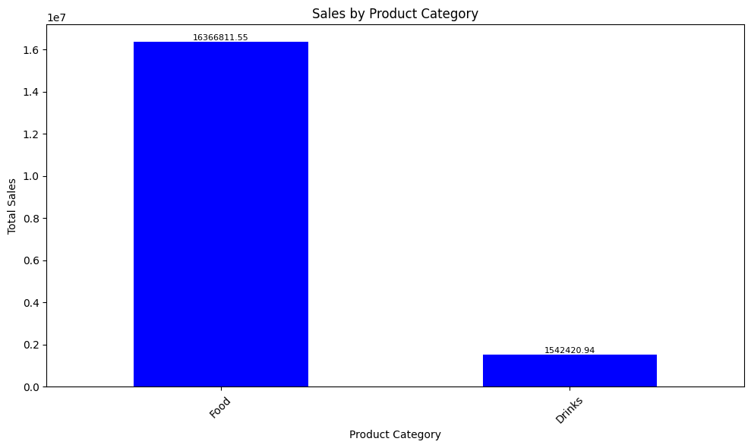
Sales by Product Category
Highest selling product category is Food. Drinks are selling low.

Slide 9
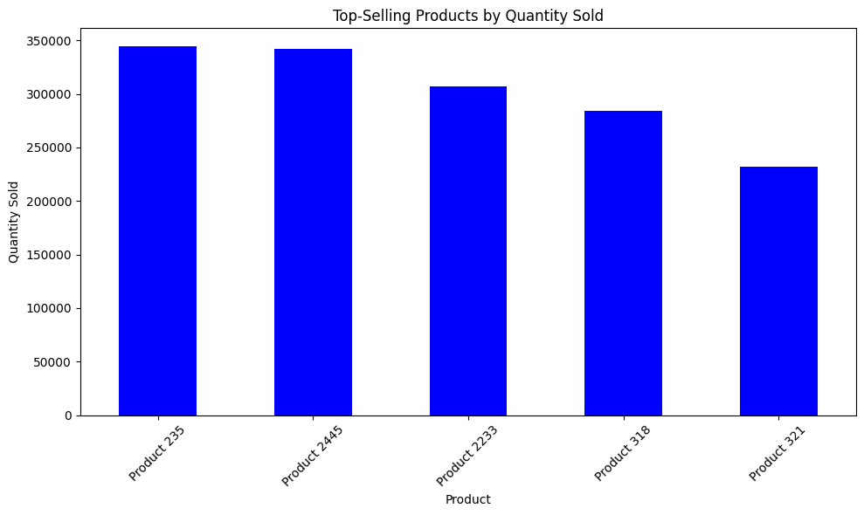
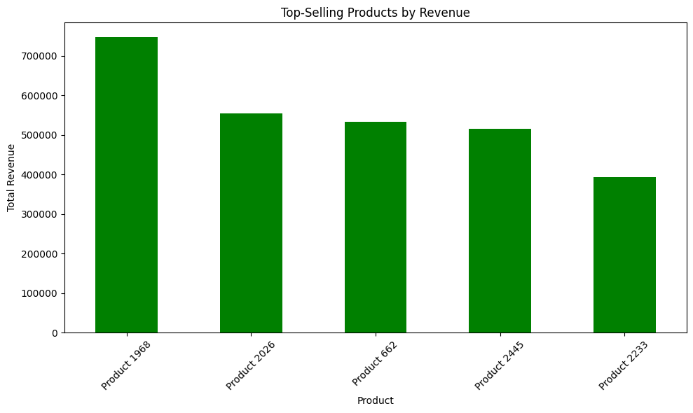
Product Performance Analysis
As we can see, top selling products by quantity sold are Product 235, Product 2445, Product 2233, Product 318, Product 321.
Where as, top selling products by Sales is Product 1963, Product 2026, Product 662, Product2445, Product2233.
Here, Product 2233 is highest selling product in terms of sales and Quantity.

Slide 10
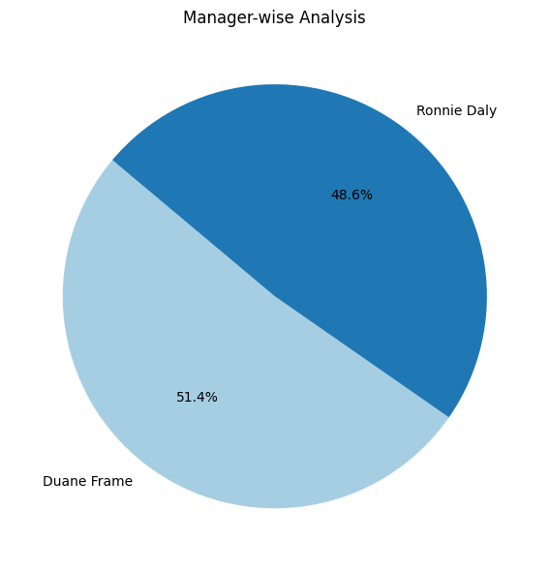
Manager wise Analysis
Duane Frame made the highest contribution in sales by 51.4% and then Ronnie Daly by 48.6%.

Slide 11
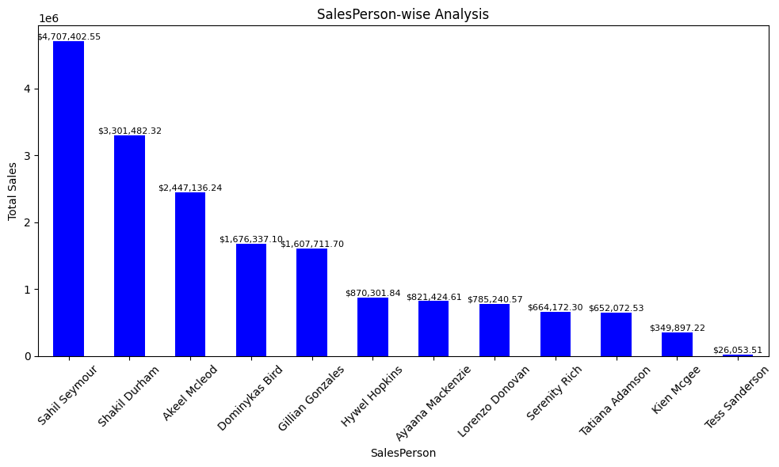
Salesperson Wise Analysis
Top 3 Salesperson are Sahil Seymour, Shakil Durham and Akeel McLeod.

Slide 12
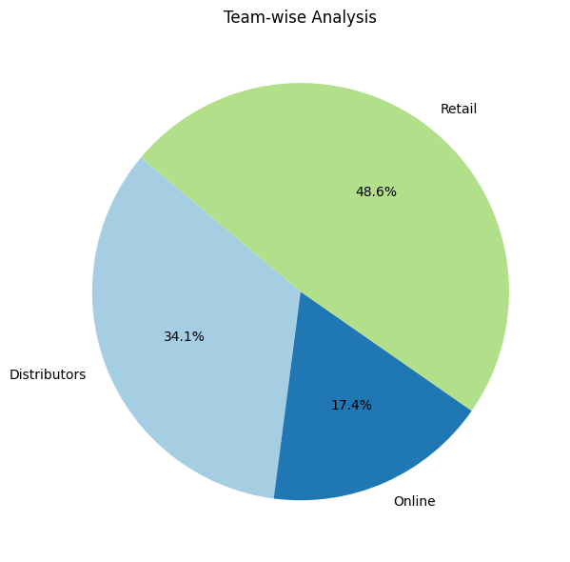
Team Wise Analysis
In team wise analysis, Retails team’s sales is highest by 48.6% then comes Distributors team by 34.1% and then Online team by 17.4%

Slide 13
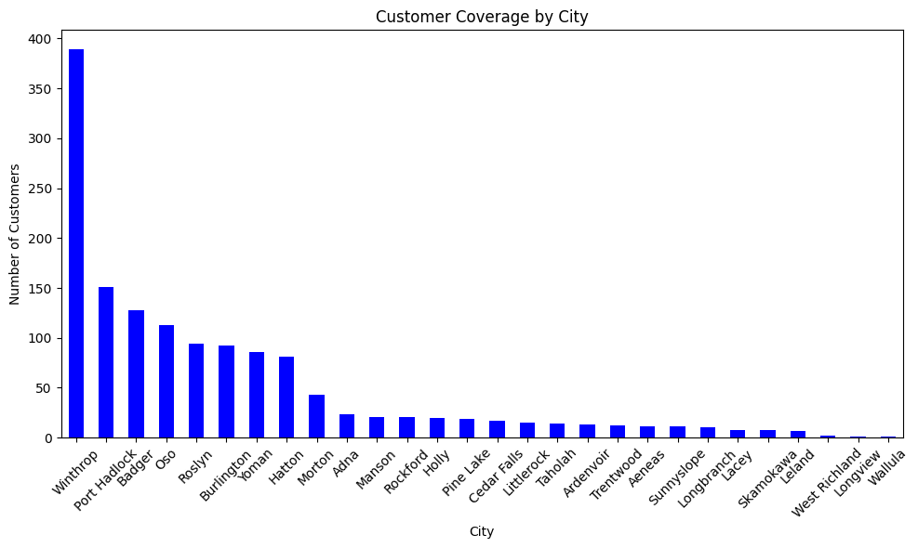
Customer Coverage by Location
Top 5 cities are Winthrop, Port Hadlock, Badger, Oso, Roslyn where the highest number of companies belongs.

Slide 14
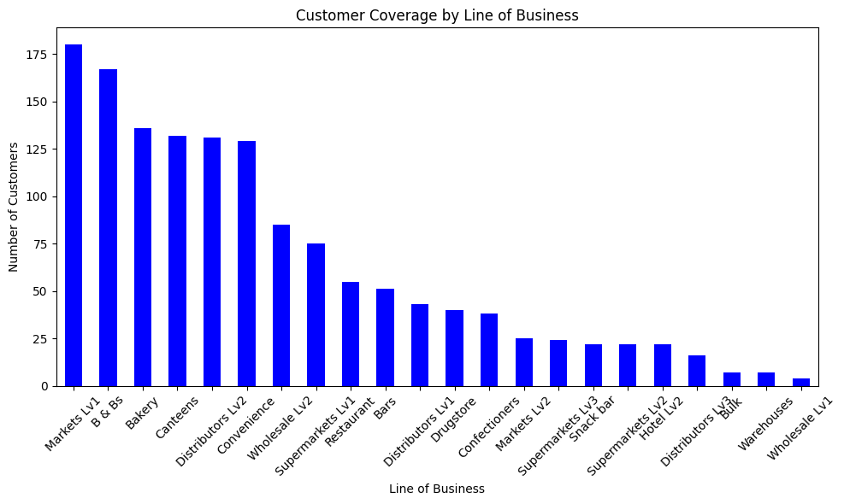
Customer analysis by Line of Business
Top Customers are belonging to the businesses like Market Lv1, B & Bs, Bakery, Canteens, Distributors Lv2 and Convenience.

Slide 15
Recommendations
Allocate resources and efforts based on the historical performance of 2018, which had the highest sale.
Invest in the food category, which is the top-performing category. So, allocate marketing and inventory resources to promote and expand the food category.
Address the lower sales in the drinks category and analyze the reasons behind the lower sales in drinks and consider strategies for improvement.
Leverage the popularity of top-selling products. Develop marketing campaigns or bundles featuring Product 235, Product 2445, Product 2233, Product 318, and Product 321 to further boost sales.
Acknowledge the top-performing salespeople and teams. Share success stories and best practices from Sahil Seymour, Shakil Durham, Akeel McLeod, and the Retails team to inspire others.
Explore opportunities for improving the performance of the Online team. Conduct a detailed analysis to identify the challenges faced by the Online team and provide necessary resources and training for improvement.
Strengthen relationships with top cities and customer segments.

Slide 16
Sales Analysis Dashboard
Tool Used: PowerBI

Slide 17
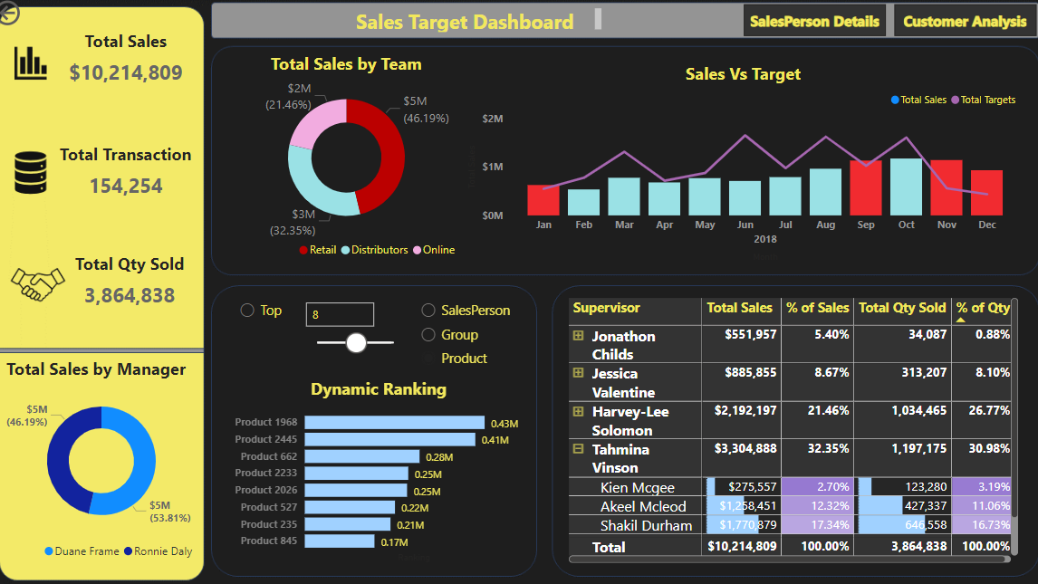
Home Page

Slide 18
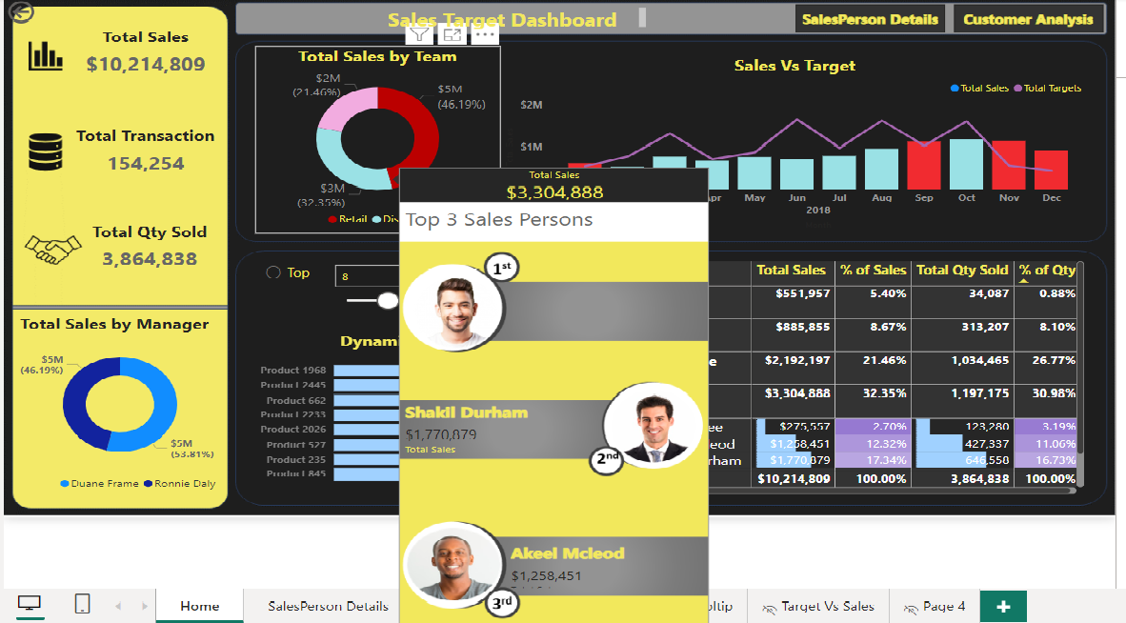
Top 3 Salesperson Tooltip

Slide 19
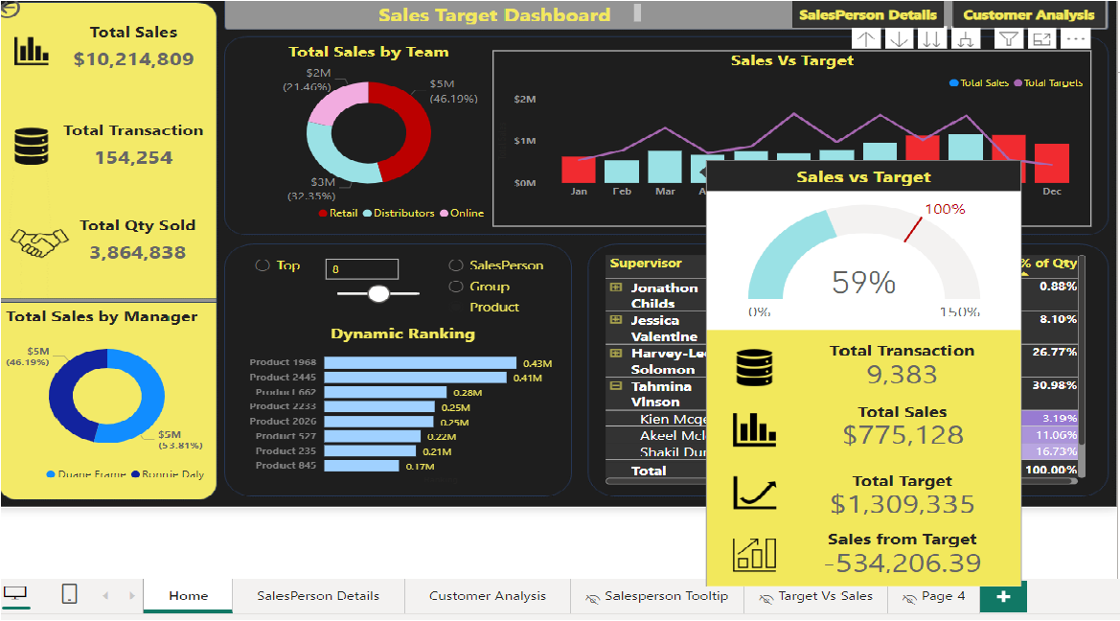
Sales Vs Target Tooltip

Slide 20
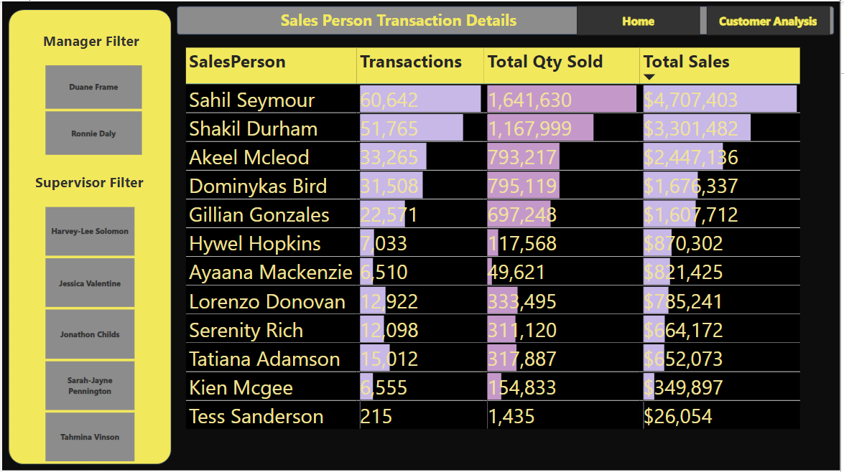
Salesperson Analysis

Slide 21
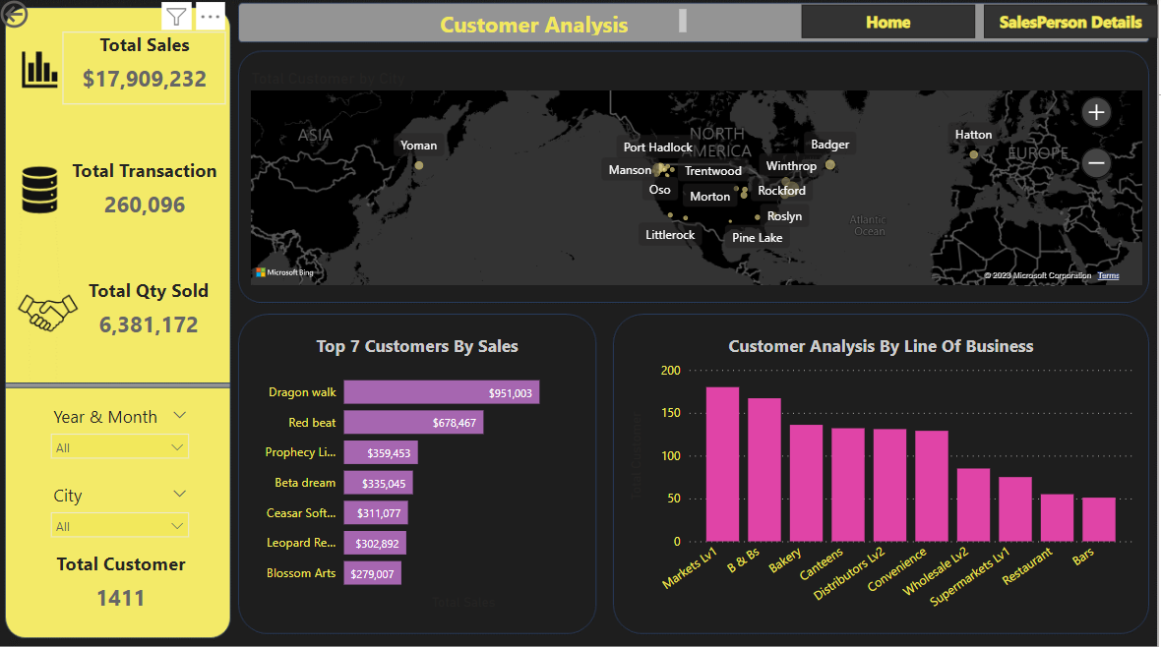
Customer Analysis

